Slide 1

Visualizing World Economic Trends
UC Berkeley Extension Data Analytics
Liza Hartlaub, Marlon Schieber, Paul Song, Ray Zhang

Slide 2

United Nations Country Data
Summary of the data
Data Sets Used: United Nations Country Statistics, 20 international statistical sources compiled by the Statistics Division and the Population Division of the United Nations, from the year 2017.
country_profile_variables.csv [Columns:47 economic indicators such as: health, education, technology, CO2 emissions, etc.
country_profile_variables.csv [Rows:229 Countries]

Slide 3

Key Questions
How does economic success [measured by Gross Domestic Product or GDP] correlate with technology, environmental, social indicators?
How does economic success and size correlate with types of economic sectors such as the agriculture, industry or the service sector? How does employment within these sectors affect economic success?
How does international trade affect economic growth in GDP?
In turn, does economic success affect life expectancy, health expenditure, education and other social factors?

Slide 4



Python Libraries Utilized
import pandas as pd
import numpy as np
import matplotlib.pyplot as plt
import csv
import os

Slide 5
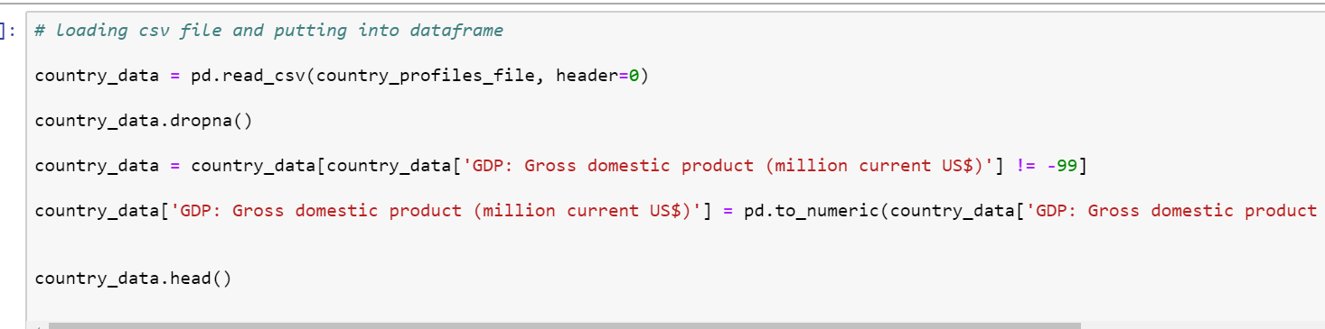
Data Cleaning

Slide 6
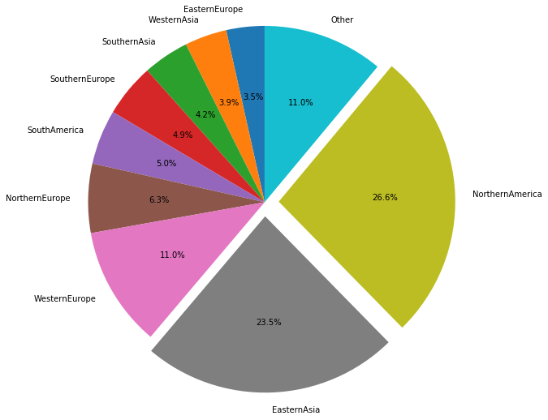
Percentage of Global GDP by Region

Slide 7
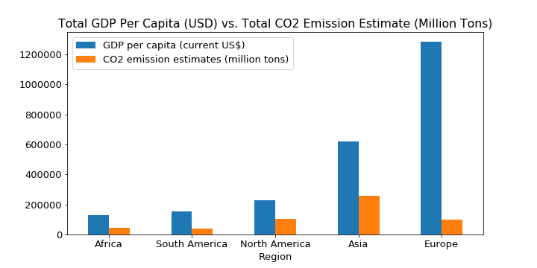
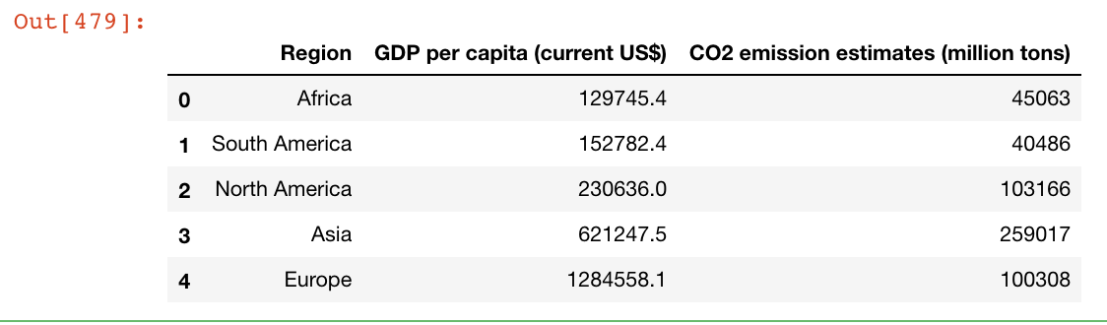
CO₂ Levels Relative to GDP by Region
The European region has the highest total GDP per capita at $1,284,558.10 while Asia has the highest estimated CO₂ emissions at 259,017 million tons.
What does this tell us about how Carbon efficient a region is?

Slide 8
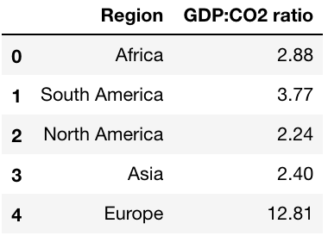
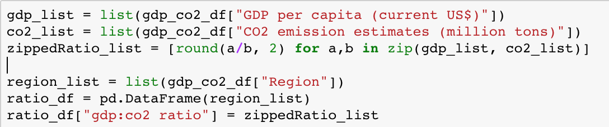
Utilizing List Comprehensions

Slide 9
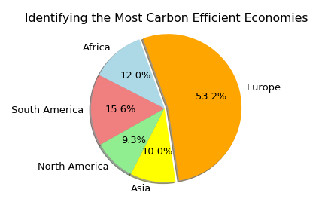
The Most Carbon Efficient Economies
Europe has the most Carbon efficient economy by a wide margin, while while North America and Asia come in at the bottom.

Slide 10
Life Expectancy

